Slide 1
Trainer connect

Slide 2
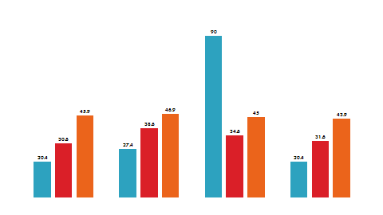
Today’s Agenda
Topics:
SQL concepts
Join
Subqueries
Java concepts
Loops
Arrays
Strings

Slide 3

SQL Concepts
Joining tables , Sub Query

Slide 4
SQL Join: Introduction
SQL Joins are mostly used when a user is trying to extricate data from multiple tables (which have one-to-many or many-to-many relationships with each other) at one time.
The join keyword merges two or more tables and creates a temporary image of the merged table.
Then according to the conditions provided, it extracts the required data from the image table, and once data is fetched, the temporary image of the merged tables is dumped.

Slide 5
SQL Join : Requirement
Large databases are often prone to data redundancy, i.e., the creation of repetitive data anomalies :
by insertion, deletion, , updation.
By using SQL Joins, we promote database normalization, which reduces data redundancy and eliminates redundant data.
In relational databases like SQL, there are two key fields generally used: Primary and Foreign key.
While the primary key is necessary for a table to qualify as a part of the relational database and identify each row uniquely of the table to which it belongs, the foreign key is responsible for linking two tables in the database.
Here, the foreign key needs to be the primary key of another table.

Slide 6
SQL Join : Classification
CROSS JOINS in SQL
SELF JOIN in SQL
INNER JOIN in SQL
OUTER JOINS in SQL

Slide 7
SQL Join : Cross Join
The Cartesian Join or Cross Join, is the cartesian product of all the rows of the first table with all the rows of the second table.
Ex: we have m rows in the first table and n rows in the second table. Then the resulting cartesian join table will have m*n rows.
This usually happens when the matching column or WHERE condition is not specified.

Slide 8
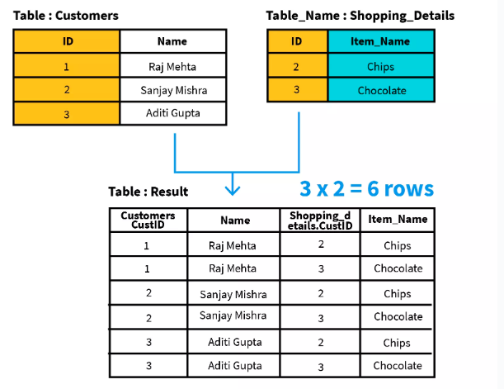
SQL Join : Cross Join
Example - Let’s consider the scenario where the table customer details, i.e., customer id and customer name, and table contains shopping details, i.e., product id and product name.
Problem: Write a query to give the cartesian product of the Customers and Shopping_Details tables.
Solution:
SELECT *
FROM Customers CROSS JOIN Shopping_Details;

Slide 9
SQL Join : Self Join
In SQL Self Join, a table is joined to itself.
means each row of the table is joined with itself and all other rows concerning stated conditions if any.
It is a merge between two copies of the same table.
This is extremely helpful when the foreign key references the primary key of the same table.

Slide 10
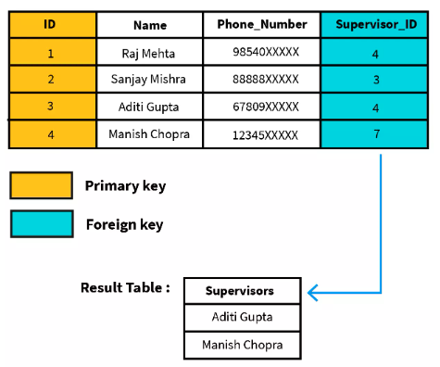
SQL Join : Self Join
Example : consider an employee table with following details, i.e., employee id, name, phone number, and supervisor id. The supervisors are present at the employee table itself. Hence, the supervisor id acts like a foreign key which is also the primary key as it references the employee id.
Problem :Write a query to get all the employees who are also supervisors of some other employees from the given employee's table.
Solution:
SELECT a.Name AS Supervisors
FROM Employees a, Employees b
WHERE a.ID = b.supervisor_ID;

Slide 11
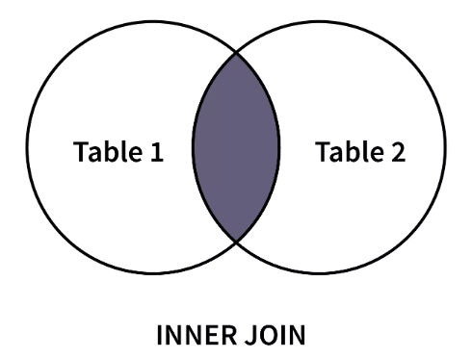
SQL Join : Inner Join
SQL Inner Join or Equi Join is the simplest join where all rows from the intended tables are cached together if they meet the stated condition.
Two or more tables are required for this join.
Inner Join can be used with various SQL conditional statements like –
WHERE, GROUP BY, Order By etc.

Slide 12
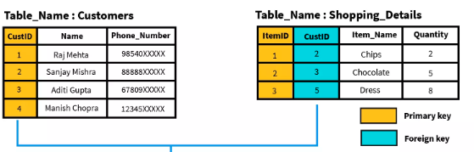
SQL Join : Inner Join
Customers gives information customer id, name, and phone number. Here, CustID is the primary key that uniquely identifies each row.
Shopping_Details, gives information item id, customer id (referencing the customer that bought the item), item name, and quantity.

Slide 13
SQL Join : Inner Join
Problem : Write a query to get all the customers who have bought items from the store. Display their name, item bought, and quantity.
Solution :
SELECT Customers.Name, Shopping_Details.Item_Name, Shopping_Details.Quantity
FROM Customers INNER JOIN Shopping_Details
WHERE Customers.ID==Shopping_Details.ID;

Slide 14
SQL Join : Outer Join
SQL Outer joins give both matched and unmatched rows of data depending on the type of outer joins. These types are outer joins are sub-divided into the following types:
Left Outer Join / Right Outer Join / Full Outer Join
LEFT OUTER JOIN - all the rows of the left-hand table, regardless of following the stated conditions are added to the output table. At the same time, only matching rows of the right-hand table are added.
RIGHT OUTER JOIN - all the rows on the right-hand table, regardless of following the stated conditions, are added to the output table. At the same time, only matching rows of the left-hand table are added.
FULL OUTER JOIN - all the rows matching the stated condition in the query and then adds the remaining unmatched rows from both tables. We need two or more tables for the join.

Slide 15
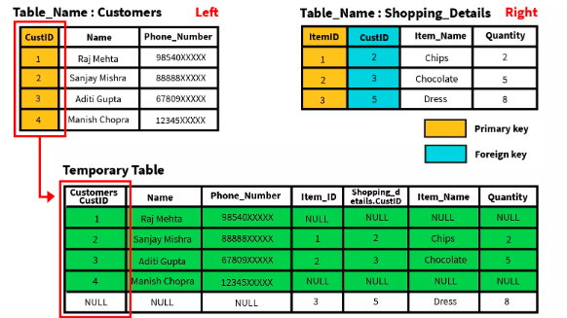
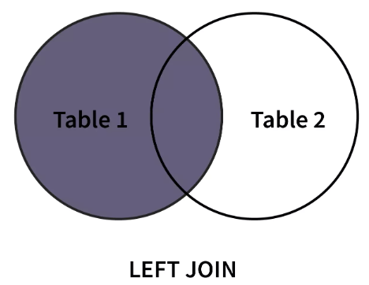
SQL Join : Outer Join
Problem : Write a query to display all customers irrespective of items bought or not. Display the name of the customer, and the item bought. If nothing is bought, display NULL.
Solution :
SELECT Customers. Name, Shopping_Details.Item_Name
FROM Customers LEFT OUTER JOIN Shopping_Details;
ON Customers.ID = Shopping_Details.ID;

Slide 16
SQL Sub Query: Introduction
Reduces programming effort by providing data structures and algorithms so you don't have to write them yourself.
Increases performance by providing high-performance implementations of data structures and algorithms.
Provides interoperability between unrelated APIs by establishing a common language to pass collections back and forth.
Reduces the effort required to learn APIs by requiring you to learn multiple ad hoc collection APIs.
Fosters software reuse by providing a standard interface for collections and algorithms with which to manipulate them.

Slide 17
SQL Sub Query: Syntax
SELECT column FROM table
WHERE column OPERATOR ( SELECT column FROM table );
Here,
column is the name of the column(s) to filter
OPERATOR is any SQL operator to connect the two queries
table is the name of the table to fetch the column from

Slide 18
SQL Sub Query: Example
-- select all the rows from the Customers table with the minimum age
SELECT * FROM Customers WHERE age = (
SELECT MIN(age) FROM Customers );
-- select the customers who have made orders
SELECT customer_id, first_name FROM Customers WHERE customer_id IN (
SELECT customer_id FROM Orders );

Slide 19
SQL Sub Query Vs Join
In some scenarios, we can get the same result set using a subquery and Join
-- SELECT DISTINCT only selects the unique combination of customer_id and first_name
-- join the Customers and Orders tables and select the rows where their customer_id values match
-- result set contains customer_id and first_name of customers who made an order
SELECT DISTINCT Customers.customer_id, Customers.first_name FROM Customers
INNER JOIN Orders ON Customers.customer_id = Orders.customer_id
ORDER BY Customers.customer_id;
-- display the distinct customer ids and first names of customers who made an order using a subquery
SELECT customer_id, first_name FROM Customers WHERE customer_id IN (
SELECT customer_id FROM Orders );

Slide 20

Java
Object Oriented Programming Language

Slide 21
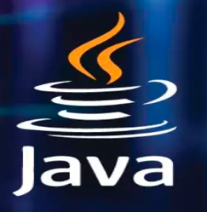
Java : Concepts
Java is a programming language and computing platform first released by Sun Microsystems in 1995.
It has evolved from humble beginnings to power a large share of today’s digital world, by providing the reliable platform upon which many services and applications are built.
It follows Object Oriented Programming concept model.
It is robust , secured, platform neutral language.
Java Virtual Machine is only one part of Java software that is involved in running an application.
It supports Java Virtual Machine is built right into your Java software download, part of the JRE and helps run Java applications.

Slide 22
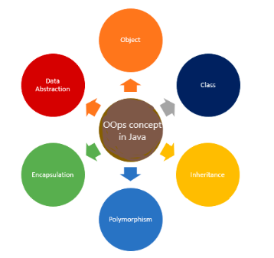
OOP : Principles
Abstraction, Encapsulation, Inheritance, and Polymorphism :

Slide 23
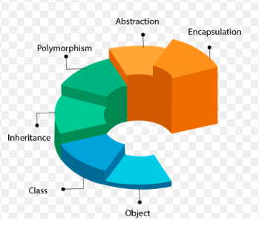
OOP : Principles
Abstraction, Encapsulation, Inheritance, and Polymorphism :
Abstraction is a property of hiding the internal implementation and highlighting the setup services beneficial to the user.
Like: smartphone user does not know the internal performance of the Smartphone and its workings; instead, they are interested in the services provided by the Smartphone.
In Java, we can achieve abstraction in two ways.
Using abstract Class
using interfaces

Slide 24
OOP : Principles
Abstraction, Encapsulation, Inheritance, and Polymorphism :
Encapsulation is a mechanism to bundle the data and code acting on the data together as a single unit.
There are two ways to achieve encapsulation in Java
declare the variable of a class as private
Provide a Public setter and getter method to modify and view the values of the variables.
Advantages of encapsulation
Loosely coupled code
Better access control and security

Slide 25
OOP : Principles
Abstraction, Encapsulation, Inheritance, and Polymorphism :
Inheritance is a procedure to inherit the features from parent to child in the real world.
Inheritance in OOPS is a procedure by which one Class acquires all the properties and behaviors of the parent class.
Inheritance ensures the reusability of the code.
Advantages of Inheritance
Code reusability

Slide 26
OOP : Principles
Abstraction, Encapsulation, Inheritance, and Polymorphism :
Polymorphism :Poly means many, and morphism means forms.
We know that Water also exists in multiple states, such as Solid, Liquid, and Gas, that means Water shows Polymorphism.
Here, we can achieve Polymorphism using methods.
There are two types of Polymorphism that JAVA supports:
Compiletime (method overload)
Runtime (method override)

Slide 27
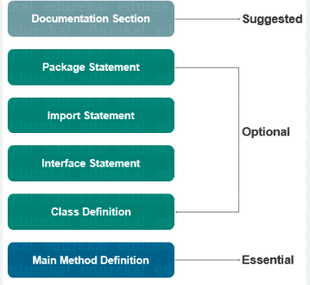
Java Program: Structure
Documentation Section
Package Declaration
Import Statements
Interface Section
Class Definition
Class Variables and Variables
Main Method Class
Methods and Behaviors

Slide 28
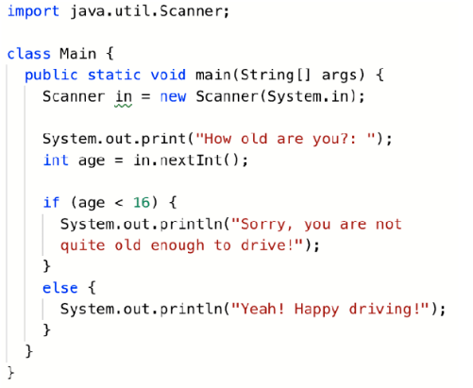
Java Program: Sample

Slide 29
Java : Memory
Heap and the Nursery
Java objects reside in an area called the heap. The heap is created when JVM starts up and may increase or decrease in size while the application runs.
When heap becomes full, garbage is collected. During garbage collection objects that are no longer used are cleared, thus making space for new objects.
JVM uses more memory than just the heap. For example Java methods, thread stacks and native handles are allocated in memory separate from the heap, as well as JVM internal data structures.

Slide 30
Java : Memory
Heap and the Nursery
The heap is sometimes divided into two areas (or generations) called the nursery (or young space) and the old space.
The nursery is a part of the heap reserved for allocation of new objects.
When the nursery becomes full, garbage is collected by running a special young collection, where all objects that have lived long enough in the nursery are promoted (moved) to the old space, thus freeing up the nursery for more object allocation.
When the old space becomes full, garbage is collected there, a process called an old collection.

Slide 31
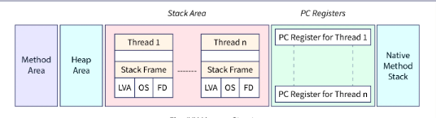
Java : Memory Structure
Method Area :
The heap memory, which is shared by all threads, includes a section called Method Area. When the JVM starts, it creates.
The name of the superclass, the name of the interface, and the constructors are all stored there.
It includes elements specific to each class, including fields, constant pools, method local data, method codes, Constructor codes, etc., that are used to initialize objects and interfaces.

Slide 32
Java : Memory Structure
Heap Area :
The objects that are produced while a Java program is running are kept in heap memory.
When compared to stack, heap memory is larger in size.
The garbage collector automatically removes any unnecessary objects from the heap memory.

Slide 33
Java : Memory Structure
Stack Area :
When a thread starts, the stack area is generated. It might have a fixed size or a variable size.
Each thread has its allocation of stack memory. Data and unfinished results are stored there.
There are heap object references in it.
The term "scope" refers to the visibility of the variables that are kept in the stack.
It is not necessary for stack memory to be continuous.

Slide 34
Java : Loop
Java provides repetition statements/looping statements that enable programmers to control the flow of execution by repetitively performing a set of statements as long as the continuation condition remains true.
These three looping statements are called :
For
While
do… while statements.
There is a common structure of all types of loops, such as:
There is a control variable, called the loop counter and control variable must be initialized.
The increment/decrement of the control variable, which is modified each time the iteration of the loop occurs.
The loop condition that determines if the looping should continue or the program should break from it.

Slide 35
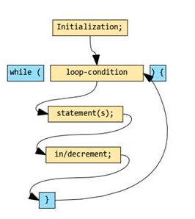
Java : Loop-1
Code Fragment for : while loop
int counter = 1; // Control variable initialized
// Condition for loop continuation
while (counter <= 10) {
System.out.println(counter);
counter++; // Increment the control variable
}

Slide 36
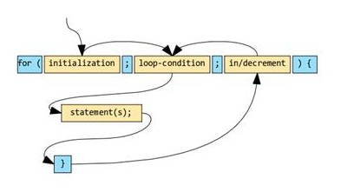
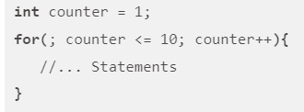
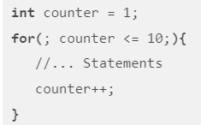

Java : Loop-2
Code Fragment for : for loop
// For(<initialization>;<condition>;<increment>
for(int counter = 1; counter <= 10; counter++){
System.out.println(counter);
}

Slide 37
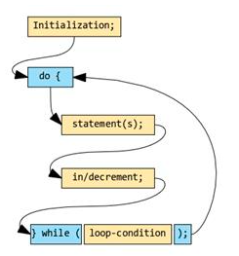
Java : Loop-3
Code Fragment for : do… while loop
int counter = 1; // Control variable initialized
do{
System.out.println(counter);
counter--; // Decrements the control variable
}while(counter <= 10); // Condition statement

Slide 38
Java : Loop-3
The significant difference that sets the do…while loop apart from both while and for loop is that:
for and while loops are meant to execute zero or more times. This means there is a chance that the loop may not execute at all if the condition is false.
do…while loop executes at least once or, in other words, one or more times because it never checks any condition during its entry.
it evaluates the loop continuation condition statement only at the exit.
this makes the body of the loop execute at least once.

Slide 39
Java String Handling
A string is a sequence of characters surrounded by double quotations.
In a java programming language, a string is the object of a built-in class present in java,lang package.
In the background, the string values are organized as an array of a character data type.
The string created using a character array can not be extended.
It does not allow to append more characters after its definition, it is immutable.
The String class defined in the package java.lang package.
The String class implements Serializable, Comparable, and CharSequence interfaces.

Slide 40
Java String Handling
Creating String object in java
In java, we can use the following two ways to create a string object.
Using string literal
Using String constructor
Let's look at the following example java code.
String title = "Java Tutorials";
// Using literals
String siteName = new String("www.btechsmartclass.com");
// Using constructor

Slide 41
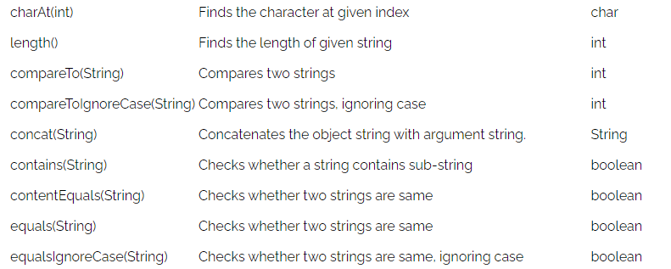
String : methods

Slide 42
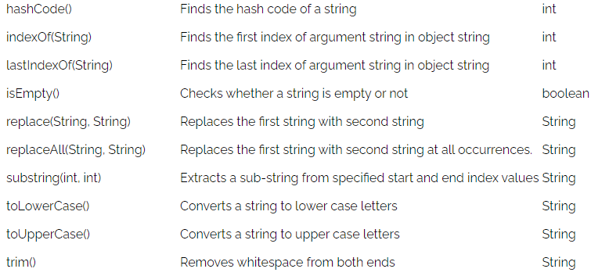
String : methods

Slide 43
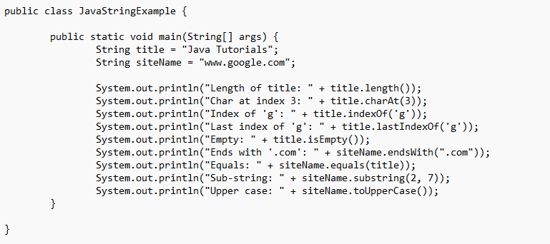
String : Demo

Slide 44
String vs StringBuffer vs StringBuilder
String is immutable in Java, whenever any manipulation done on string like concatenation, substring, etc. it generates a new String and discards the older String for garbage collection.
These are heavy operations and generate a lot of garbage in heap. Java has provided StringBuffer and StringBuilder classes that should be used for String manipulation.
StringBuffer and StringBuilder are mutable objects in Java. They provide append(), insert(), delete(), and substring() methods for String manipulation.
StringBuffer was the only choice for String manipulation until Java 1.4. It has one disadvantage that all of its public methods are synchronized.
StringBuffer provides Thread safety but at a performance cost. In most of the scenarios, we don’t use String in a multithreaded environment.
Java 1.5 introduced a new class StringBuilder, which is similar to StringBuffer except for thread-safety and synchronization.

Slide 45
Thank You
☺
4x3
16x9

